Slide 1

Mémoriser
Group 8

Slide 2
Key Features
Text Compression
Highlighting
Share

Slide 3

Additional Features
Notification
Autosave
Style Configuration
Temporary File
Multi-Language System

Slide 4
Job Desc
Name | NPM | Job Description
Ramadhan Kalih Sewu | 1806148826 | GUI Framework, Compression, Version-Control or Git
Suryanegara | 1806200002 | Desktop Frontend, Language Translator, Built-In Dictionary
Yogie Wisesa | 1806148851 | Android Frontend, Language Translator, Built-In Dictionary

Slide 5
System Requirement
Operating System
Windows 10
Linux with GNOME
Android 7.0
Hardware Spec
RAM 100 MB
Storage 100 MB
Any Modern CPU

Slide 6
Tools
Figma
Android Studio/Flutter
MSVC C++
wxWidget

Slide 7
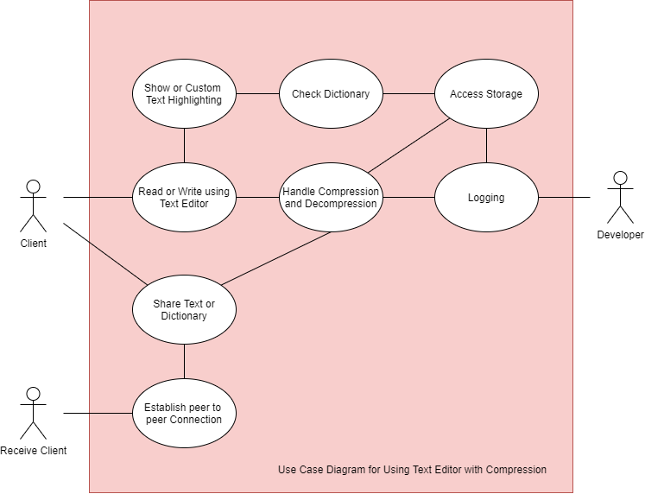
Use Case Diagram

Slide 8
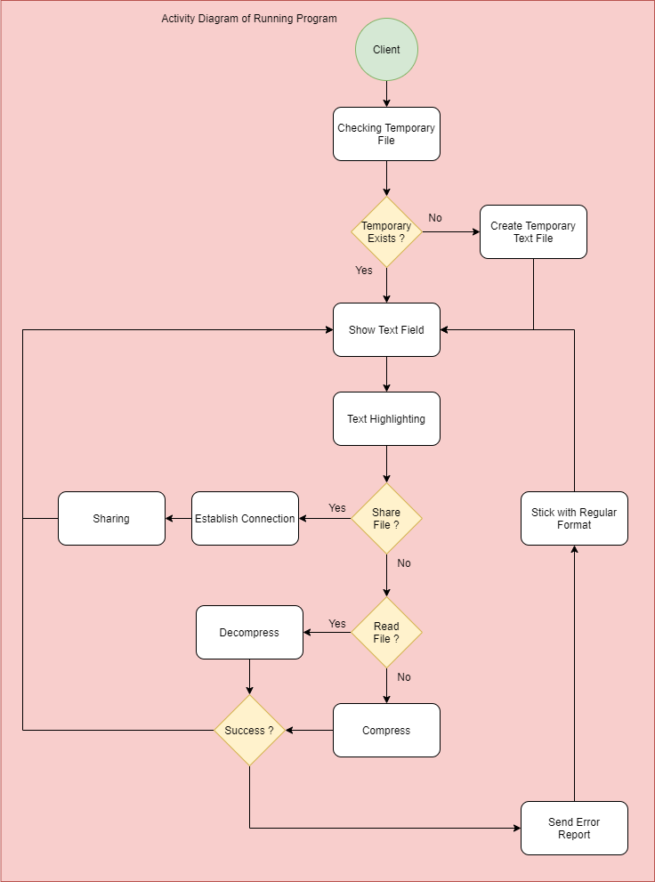
Activity Diagram

Slide 9
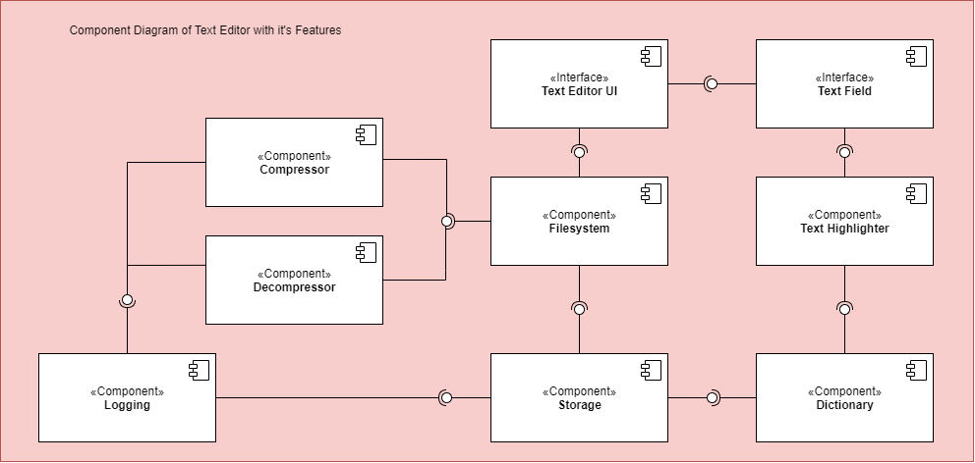
Component Diagram

Slide 10
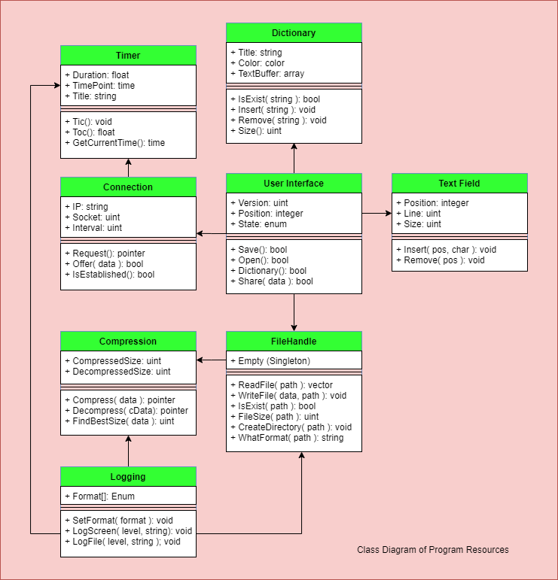
Class Diagram

Slide 11
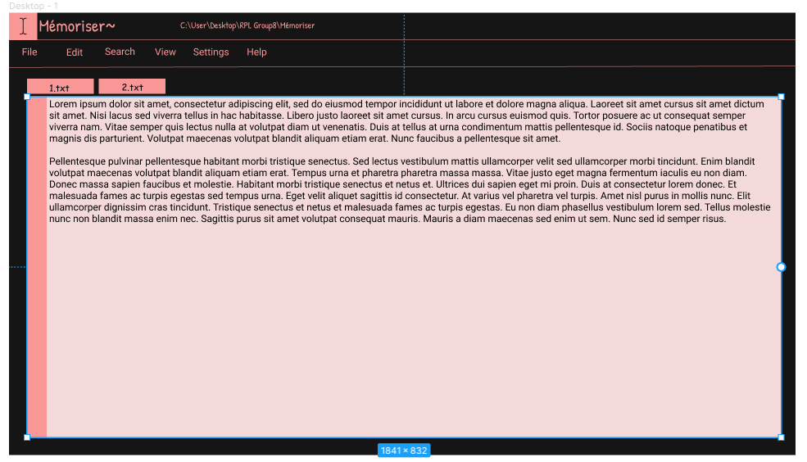

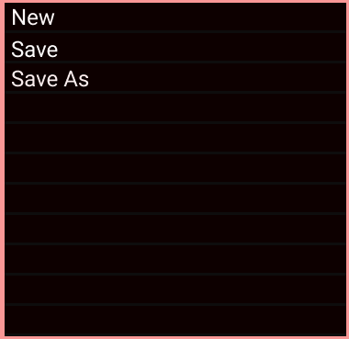
GUI Design (Dekstop)
https://www.figma.com/file/1pHi1inxI974b75BiBktDi/Dekstop?node-id=0%3A1

Slide 12
GUI DESIGN (ANDROID)
https://www.figma.com/proto/jJO5Ummi1gPPutQApckssr/Untitled?node-id=4%3A2&scaling=scale-down

Slide 13
